Slide 1
WeatherPy
Impact of Latitude on Weather
Simon Alizadeh

Slide 2
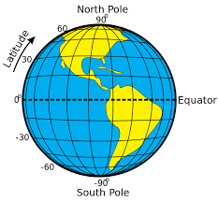
What's the weather like as we approach the equator?
Equator is halfway between the North Pole and the South Pole, at 0 degrees latitude.

Slide 3
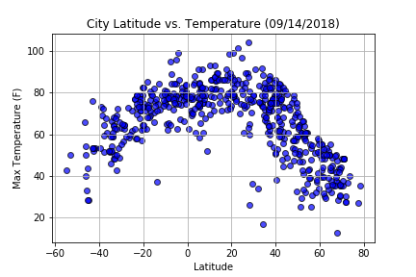
Temperature (F) vs. Latitude
Temperature increases significantly the closer we get to the equator.
Rough bell shape of the scatter plot above indicates that at this time of year, there is no significant difference in temperature between northern and southern hemispheres – 80 to 100F.
Note, the random city generator algorithm churns out more cities on the Northern hemisphere. This could be due to the fact that the Northern hemisphere is vastly more populated than the Southern hemisphere with the Northern hemisphere containing around 88% of the world's population. More population means more cities in the north hence the bias in the algorithm.

Slide 4
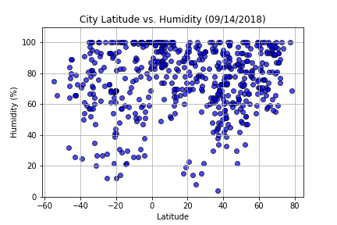
Humidity (%) vs. Latitude
Scatter plot does not indicate a significant relationship between humidity and latitude on either side of the equator at this time of year, if we allow for the city generator bias toward Northern hemisphere.

Slide 5
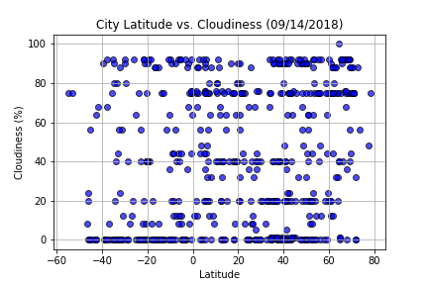
Cloudiness (%) vs. Latitude
Scatter plot does not indicate a relationship between cloudiness and latitude on either side of the equator at this time of year, if we allow for the city generator bias toward Northern hemisphere.

Slide 6
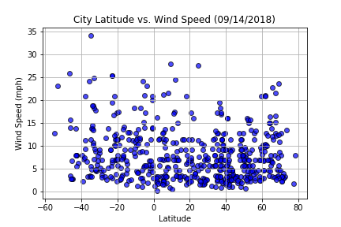
Wind Speed (mph) vs. Latitude
Scatter plot does not support a strong relationship between wind speeds and latitude on either side of the equator at this time of year, if we allow for the city generator bias toward Northern hemisphere.

